Slide 1
Developing an Auto Trader
Daniel Lobenstein
James Pierce McCarty
Brendan Gross

Slide 2


Project Introduction
Trading Application with the ability to trade manually or automatically based on user defined strategies.
Receives live data via Rest API and submits trades using a third party broker API
Interactable GUI
View Portfolio
View, purchase, and sell stocks, crypto, etc.
Start and stop Auto Trading
Create new strategies

Slide 3
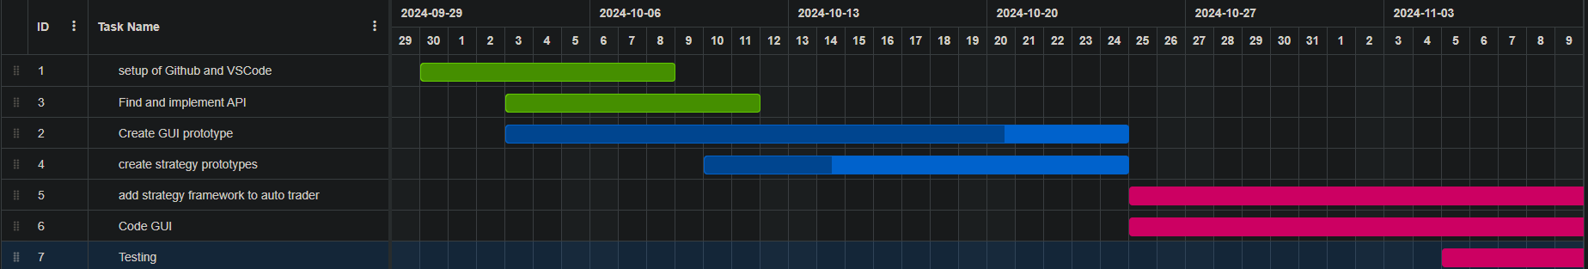
Gantt Chart

Slide 4

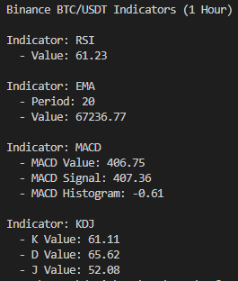
Taapi.IO API
Free access to live data and indicators of stocks, ETFs, Crypto, and more
Easy implementation into python project using REST API
Limited request rate, scalable by purchasing higher request rate

Slide 5

GUI/Demo
Plan to use the Tkinter library to build the GUI in Python.
No previous front end development experience makes it easier
Demo / Prototype

